Slide 1
AZ-900T0x Module 03: Security, privacy, compliance, and trust
Notes:
Adjust the cover for either AZ-900T00 or AZ-900T01.

Slide 2
Lesson 01: Learning objectives

Slide 3
Module 3 – Learning objectives
Understand and describe how to secure network connectivity in Microsoft Azure.
Understand and describe core Azure identity services.
Understand and describe security tools and features.
Understand and describe Azure governance methodologies.
Understand and describe monitoring and reporting in Azure.
Understand and describe privacy, compliance, and data protection standards in Azure.

Slide 4
Lesson 02: Securing network connectivity

Slide 5
Defense in depth
Physical Security
A layered approach to securing computer systems.
Provides multiple levels of protection.
Attacks against one layer are isolated from subsequent layers.
Identity & Access
Perimeter
Network
Compute
Application
Data
Notes:
This is conceptual, to be kept high level, explaining how security options can be targeted at each layer.

Slide 6
Shared security
Responsibility | On-Premises | IaaS | PaaS | SaaS
Data governance and Rights Management | Customer | Customer | Customer | Customer
Client endpoints | Customer | Customer | Customer | Customer
Account and access management | Customer | Customer | Customer | Customer
Identity and directory infrastructure | Customer | Customer | Microsoft/ Customer | Microsoft/ Customer
Application | Customer | Customer | Microsoft/ Customer | Microsoft
Network controls | Customer | Customer | Microsoft/ Customer | Microsoft
Operating system | Customer | Customer | Microsoft | Microsoft
Physical hosts | Customer | Microsoft | Microsoft | Microsoft
Physical network | Customer | Microsoft | Microsoft | Microsoft
Physical datacenter | Customer | Microsoft | Microsoft | Microsoft
Migrating from customer-controlled to cloud-based datacenters shifts the responsibility for security.
Security becomes a shared concern between cloud providers and customers.
Notes:
This is comparable to the Shared Responsibility slide, but specific to security.

Slide 7
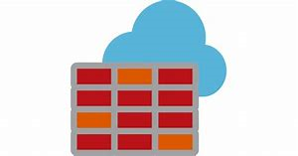
Azure Firewall
Stateful, managed, Firewall as a Service (FaaS) that grants/ denies server access based on originating IP address, to protect network resources.
Applies inbound and outbound traffic filtering rules.
Built-in high availability.
Unrestricted cloud scalability.
Uses Azure Monitor logging.
✔️ Azure Application Gateway also provides a firewall, Web Application Firewall (WAF). WAF provides centralized, inbound protection for your web applications.
Notes:
✔️ Azure Application Gateway also provides a firewall, called the Web Application Firewall (WAF). WAF provides centralized, inbound protection for your web applications against common exploits and vulnerabilities.
Azure Firewall - https://azure.microsoft.com/en-us/services/azure-firewall/

Slide 8
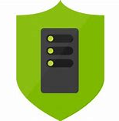
Azure Distributed Denial of Service (DDoS) protection
DDoS attacks overwhelm and exhaust network resources, making apps slow or unresponsive.
Sanitizes unwanted network traffic, before it impacts service availability.
Basic service tier is automatically enabled in Azure.
Standard service tier adds mitigation capabilities, tuned to protect Azure Virtual Network resources.
Notes:
Azure DDoS Protection - https://azure.microsoft.com/en-us/services/ddos-protection/

Slide 9

Network Security Groups (NSGs)
Filters network traffic to, and from, Azure resources on Azure Virtual Networks.
Set inbound and outbound rules to filter by source and destination IP address, port, and protocol.
Add multiple rules, as needed, within subscription limits.
Azure applies default, baseline, security rules to new NSGs.
Override default rules with new, higher priority, rules.
Notes:
NSG -https://docs.microsoft.com/en-us/azure/virtual-network/security-overview#network-security-groups

Slide 10

Application Security Groups (ASGs)
Provides for the grouping of servers with similar port filtering requirements, and group together servers with similar functions, such as web servers.
Allows you to reuse your security policy at scale without manual maintenance of explicit IP addresses.
Handles the complexity of explicit IP addresses and multiple rule sets, allowing you to focus on your business logic.
Notes:
ASG - https://docs.microsoft.com/en-us/azure/virtual-network/security-overview#application-security-groups

Slide 11
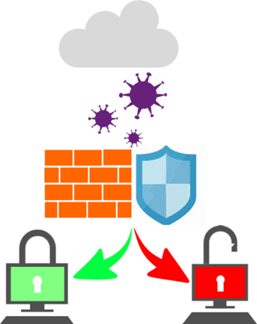
Choosing Azure network security solutions
Azure supports combined network security solutions. For example, NSGs with Azure Firewall; Web Application Firewall (WAF) with Azure Firewall.
Perimeter layer protects your networks’ boundaries with Azure DDoS Protection and Azure Firewall.
Networking layer only permits traffic to pass between networked resources with Network Security Group (NSG) inbound and outbound rules.
Notes:
This slide uses the Defense in Depth perimeter and networking layers as examples. Discussing Azure networking security solutions at each layer is beyond the scope of this course.

Slide 12
Walkthrough - Secure network traffic
Create and configure inbound and outbound security port rules.
Deploy a custom template to create a virtual machine.
Create a network security group.
Create an inbound security port rule to allow RDP.
Configure an outbound security port rule to deny Internet access.
Notes:
You can use this as a demonstration, have the students step through the tasks together, or have the students try it themselves.

Slide 13
Lesson 03: Core Azure identity services

Slide 14
Authentication and authorization
Two concepts are fundamental to understanding identity and access.
Authentication
Identifies the person or service seeking access to a resource.
Requests legitimate access credentials.
Basis for creating secure identity and access control principles.
Authorization
Determines an authenticated person’s or service’s level of access.
Defines which data they can access, and what they can do with it.
Notes:
✔️Authentication is sometimes shortened to AuthN, and authorization is sometimes shortened to AuthZ.

Slide 15

Azure Active Directory (AD)
Microsoft Azure’s cloud-based identity and access management service.
Authentication (employees sign-in to access resources).
Single sign-on (SSO).
Application management.
Business to Business (B2B).
Business to Customer (B2C) identity services.
Device management.
Notes:
Azure AD - https://azure.microsoft.com/en-us/services/active-directory/

Slide 16
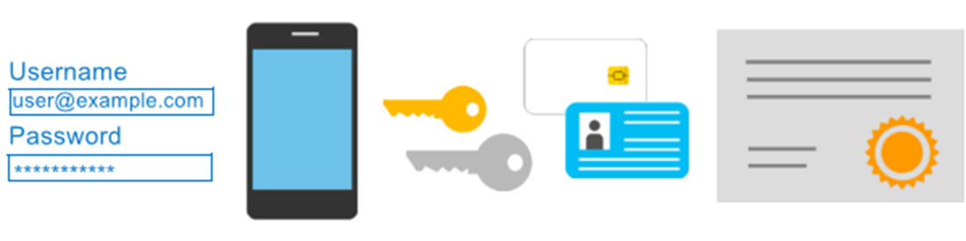
Azure Multi-Factor Authentication
Provides additional security for your identities by requiring two or more elements for full authentication.
Something you know.
Something you possess.
Something you are.
Notes:
Discuss what could qualify for each of the items listed
Something you know: This could be a password or the answer to a security question.
Something you possess: This might be a mobile app that receives a notification, or a token-generating device.
Something you are: This is typically some sort of biometric property, such as a fingerprint or face scan used on many mobile devices.
MFA - https://docs.microsoft.com/en-us/azure/active-directory/authentication/concept-mfa-howitworks

Slide 17
Lesson 04: Security tools and features

Slide 18

Azure Security Center
A monitoring service that provides threat protection across all your Azure, and on-premises, services.
Provides security recommendations based on your configurations, resources, and networks.
Monitors security settings across your on-premises and cloud workloads.
Automatically applies your security policies to any new services you provision.
Notes:
Azure Security - https://azure.microsoft.com/en-us/services/security-center/

Slide 19
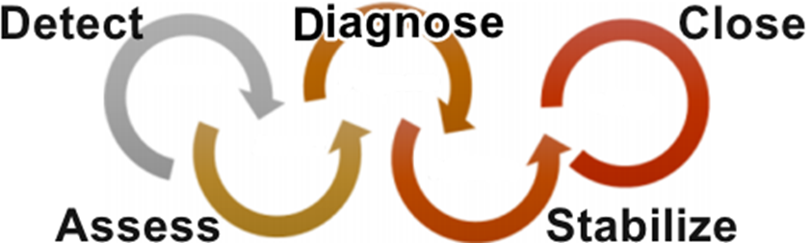
Azure Security Center usage scenarios
You can use Security Center in the Detect, Assess, and Diagnose stages of an incident response.
Use Security Center recommendations to enhance security.
Notes:
Azure Security Center planning and operations guide - https://docs.microsoft.com/en-us/azure/security-center/security-center-planning-and-operations-guide

Slide 20

Azure Key Vault
Stores application secrets in a centralized cloud location, to securely control access permissions, and access logging.
Secrets management.
Key management.
Certificate management.
Storing secrets backed by hardware security modules (HSMs).
Notes:
Azure Key Vault -https://azure.microsoft.com/en-us/services/key-vault/

Slide 21
Walkthrough-Implement Azure Key Vault
Create an Azure Key vault and then create a password secret within the key vault.
Create an Azure key vault.
Add a secret to the Azure key vault.
Notes:
You can use this as a demonstration, have the students step through the tasks together, or have the students try it themselves.

Slide 22

Azure Information Protection (AIP)
Classifies and protects documents, and emails, by applying labels.
Automatically using rules and conditions defined by administrators.
Manually, by users.
By combining automatic and manual methods, guided by recommendations.
Notes:
For purchasing details, see : https://azure.microsoft.com/en-us/pricing/details/information-protection/
AIP - https://docs.microsoft.com/en-us/azure/information-protection/what-is-information-protection

Slide 23

Azure Advanced Threat Protection (Azure ATP)
Cloud-based security solution for identifying, detecting, and investigating advanced threats, compromised identities, and malicious insider actions.
Dedicated portal for monitoring and responding to suspicious activity.
Sensors installed directly onto your domain controllers.
Cloud service runs on Azure infrastructure.
Notes:
ATP - https://azure.microsoft.com/en-us/features/azure-advanced-threat-protection/

Slide 24
Lesson 05: Azure Governance methodologies

Slide 25

Azure Policy
Stay compliant with your corporate standards and service level agreements (SLAs) by using policy definitions to enforce rules and effects for your Azure resources.
Evaluates and identifies Azure resources that do not comply with your policies.
Provides built-in policy and initiative definitions, under categories such as Storage, Networking, Compute, Security Center, and Monitoring.
Notes:
Azure Policy - https://azure.microsoft.com/en-us/services/azure-policy

Slide 26
Implementing Azure Policy
Create a policy definition
Assign the definition to resources
Review the evaluation results
A policy definition expresses what to evaluate and what action to take.
Implement your policy definition by assigning it to a group of resources.
Review the results. Results are either compliant or non-compliant.
Notes:
✔️ Policy evaluation happens about once an hour, which means that if you make changes to your policy definition and create a policy assignment then it will be re-evaluated over your resources within the hour.
Azure Policy Samples - https://docs.microsoft.com/en-us/azure/governance/policy/samples/

Slide 27
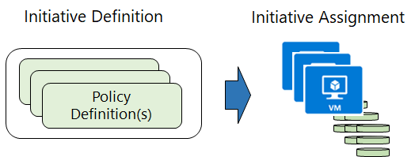
Policy Initiatives
Policy Initiatives work with Azure Policies
Initiative definitions group multiple policy definitions into a single unit, to track compliance at a higher scope. For example, one initiative can monitor all your Azure Security Center recommendations.
Initiative assignments are assigned to a specific scope and reduce the need to make an initiative definition for each scope.

Slide 28
Walkthrough - Create an Azure Policy
Create an Azure Policy to restrict deployment of Azure resources to a specific location.
Create a policy assignment.
Test the allowed location policy.
Delete the policy assignment.
Notes:
You can use this as a demonstration, have the students step through the tasks together, or have the students try it themselves.

Slide 29






Role-based access control (RBAC)
Fine-grained access management
Segregate duties within your team and grant only the amount of access to users that they need to perform their jobs.
Enables allowing or disallowing access to the Azure portal, and controlling access to resources.
Azure
Active Directory
Azure
subscription
User
Apps
User groups
Resource group
Resource group
Notes:
Azure RBAC - https://docs.microsoft.com/en-us/azure/role-based-access-control/overview

Slide 30
Walkthrough - Manage access with RBAC
Assign roles and view activity logs.
View and assign roles.
View the activity log and remove a role assignment.
Notes:
You can use this as a demonstration, have the students step through the tasks together, or have the students try it themselves.

Slide 31
Resource locks
Lock Types | Read | Update | Delete
CanNotDelete | Yes | Yes | No
ReadOnly | Yes | No | No
Protect your Azure resources from accidental deletion or modification.
Manage locks at subscription, resource group, or individual resource levels within Azure Portal.
Notes:
Resource Locks - https://docs.microsoft.com/en-us/azure/azure-resource-manager/resource-group-lock-resources

Slide 32
Walkthrough - Manage Resource Locks
Create a resource group, add a lock to the resource group and test deletion, test deleting a resource in the resource group, and remove the resource lock.
Create a resource group.
Add a resource lock to prevent deletion of a resource group.
Test deleting a member of the resource group.
Remove the resource lock.
Notes:
You can use this as a demonstration, have the students step through the tasks together, or have the students try it themselves.

Slide 33

Azure Blueprints
Create reusable environment definitions that can recreate your Azure resources and apply your policies instantly.
Help audit and trace your deployments, and maintain compliance using built-in tools and artifacts.
Associate blueprints with specific Azure DevOps build artifacts, and release pipelines, for rigorous tracking.
Notes:
Azure Blueprints - https://azure.microsoft.com/en-us/services/blueprints/

Slide 34
Subscription Governance
There are mainly three aspects to consider in relation to creating and managing subscriptions.
Billing. Reports and chargeback can be generated per subscriptions
Access Control. A subscription is a deployment boundary for Azure resources and can set up role-based access control.
Subscription Limits. Subscriptions are also bound to some hard limitations. If there is a need to go over those limits, then additional subscriptions may be needed. If you hit a hard limit, there is no flexibility.
Notes:
✔️ There is more information about subscription limits - https://docs.microsoft.com/en-us/azure/azure-subscription-service-limits

Slide 35
Lesson 06: Monitoring and reporting in Azure

Slide 36
Tags
Provides metadata for your Azure resources.
Logically organizes resources into a taxonomy.
Consists of a name-value pair.
Very useful for rolling up billing information.
OR
owner: joe
department: marketing
environment: production
cost-center: marketing
Notes:
Tags - https://docs.microsoft.com/en-us/azure/azure-resource-manager/resource-group-using-tags

Slide 37
Walkthrough – Implement resource tagging
Create a policy assignment that requires tagging, create a storage account and test the tagging, view resources with a specified tag, and remove the tagging policy.
Create a policy assignment to require tagging.
Create a storage account to test required tagging.
View all resources with a specific tag.
Delete the policy assignment.
Notes:
You can use this as a demonstration, have the students step through the tasks together, or have the students try it themselves.

Slide 38

Azure Monitor
Collect, analyze, and act on telemetry from cloud and on-premises environments, to maximize your applications’ availability and performance.
Starts collecting data as soon as you create an Azure subscription and add resources.
Activity Logs record all resource creation and modification events.
Metrics measure resource performance and consumption.
Add an Azure monitor agent to collect operational data for a resource.
Notes:
Azure Monitor - https://azure.microsoft.com/en-us/services/monitor/

Slide 39

Azure Service Health
Evaluate the impact of Azure service issues with personalized guidance and support, notifications, and issue resolution updates.
Components of Azure service health :
Azure Status provides a global overview Azure services’ state of health.
Service Health has a customizable dashboard for tracking the state of services in the regions you use.
Azure Resource Health can diagnose and obtain support for Azure service issues affecting your resources.
Notes:
Azure Service Health - https://azure.microsoft.com/en-us/services/monitor/

Slide 40
Monitoring applications and services
Integrate Azure Monitor with other Azure services to improve your data monitoring capabilities and gain better insights into your operations.
Analyze
Respond
Visualize
Integrate
Use variants of Azure Monitor for resources (containers, virtual machines, etc.), with Azure Application Insights for applications.
Azure Alerts can respond proactively to critical conditions identified in your monitor data and use Auto-scale with Azure Monitor Metrics.
Use Azure Monitor data to create interactive visualizations, charts, and tables with Power BI.
Integrate Azure Monitor with other systems to build customized solutions to suit your needs and requirements.

Slide 41
Lesson 07: Privacy, compliance, and data protection standards

Slide 42
Compliance Terms and Requirements
Microsoft provides the most comprehensive set of compliance offerings (including certifications and attestations) of any cloud service provider. Some compliance offerings include.
CJIS (Criminal Justice Information Services ) | HIPAA (Health Insurance Portability and Accountability Act)
CSA STAR Certification | ISO/IEC 27018
General Data Protection Regulation (GDPR) | National Institute of Standards and Technology (NIST)
Notes:
Should discuss the questions below with students. When selecting a cloud provider to host your solutions, you should understand how that provider can help you comply with regulations and standards. Some questions to ask about a potential provider include:
How compliant is the cloud provider when it comes to handling sensitive data?
How compliant are the services offered by the cloud provider?
How can I deploy my own cloud-based solutions to scenarios that have accreditation or compliance requirements?
You can view all the Microsoft compliance offerings at Microsoft Compliance Center - Compliance Offerings

Slide 43

Microsoft privacy statement
Provides openness and honesty about how Microsoft handles the user data collected from its products and services.
The Microsoft privacy statement explains:
What data Microsoft processes.
How Microsoft processes it.
What purposes the data is used for.
Notes:
Microsoft's Privacy Statement at - microsoft.com/privacystatement

Slide 44

Trust Center
Learn about security, privacy, compliance, policies, features, and practices across Microsoft’s cloud products.
The Trust Center website provides :
In-depth, expert information.
Curated lists of recommended resources, arranged by topic.
Role-specific information for business managers, administrators, engineers, risk assessors, privacy officers, and legal teams.
Notes:
Trust Center - https://www.microsoft.com/trustcenter

Slide 45

Service Trust Portal (STP)
A Trust Center companion website for compliance-related publications about Microsoft cloud services. Hosts the Compliance Manager service.
Use STP to access :
Audit reports across Microsoft cloud services.
Guides to using Microsoft cloud services for regulatory compliance.
Publications about trust, and how Microsoft cloud services protect your data.
Notes:
STP - https://servicetrust.microsoft.com/

Slide 46
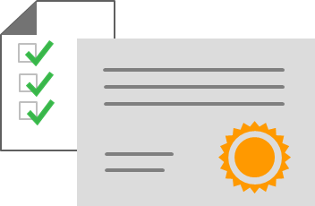
Compliance Manager
Workflow-based, risk assessment tool in Trust Portal that supports your organization's regulatory compliance activities.
Compliance Manager features :
Assign, track, and verify your compliance and assessment-related activities.
Provides a score by evaluating your compliance status.
Stores and manages your compliance-related artifacts in a secure digital repository.
Notes:
✔️ Compliance Manager is a dashboard that provides a summary of your data protection and compliance status, as well as recommendations to improve your data protection and compliance status. The Customer Actions provided in Compliance Manager are recommendations only. Each organization must evaluate the effectiveness of these recommendations, in their respective regulatory environment, prior to implementation. Compliance Manager recommendations should not be interpreted as a guarantee of compliance.

Slide 47
Walkthrough – Exploring the Trust Center
Access the Trust Center, Service Trust Portal (STP), and Compliance Manager.
Access the Trust Center.
Access the Service Trust Portal.
Access the Compliance Manager.
Notes:
You can use this as a demonstration, have the students step through the tasks together, or have the students try it themselves.

Slide 48
Azure Government services
Meets the security and compliance needs of US federal agencies, state and local governments, and their solution providers.
Azure Government :
Separate instance of Azure.
Physically isolated from non-US government deployments.
Accessible only to screened, authorized personnel.
Examples of compliant standards : FedRAMP, NIST 800.171 (DIB), ITAR, IRS 1075, DoD L2, L4 & L5, and CJIS.
Notes:
Azure Government - https://azure.microsoft.com/en-us/global-infrastructure/government/
Acronym explanations
FedRAMP : US Federal Risk and Authorization Management Program (FedRAMP) is a standardized approach for assessing, monitoring, and authorizing cloud computing products and services under the US Federal Information Security Management Act (FISMA).
NIST 800.171 (DIB) : National Institute of Standards and Technology (NIST) 800.171 standardizes security requirements for handling US Federal controlled unclassified information.
ITAR : International Traffic in Arms Regulations (ITAR) relate to managing the export and import of defense articles.
IRS 1075 : US Internal Revenue Service Publication 1075 contains guidelines for US government agencies to protect Federal tax information.
DoD L2, L4 & L5 : US Department of Defense (DoD) Levels 2, 4, and 5 are security authorization requirements for cloud service providers that host DoD information, systems, and applications.
CJIS : US Criminal Justice Information Services’ (CJIS) policies establish security requirements and controls to safeguard criminal justice information.

Slide 49
Azure China 21Vianet
China’s first foreign public cloud service provider, in compliance with government regulations.
Azure China 21Vianet features:
Physically separated instance of Azure cloud services, located in China.
Pperated by 21Vianet (Azure China 21Vianet).
Notes:
Azure China 21Vianet - https://docs.microsoft.com/en-us/azure/china/

Slide 50
Lesson 08: Module review questions
Notes:
As you have time, cover the module review questions in the student materials.

